Slide 1
Dealing with time
(Recurrent nets and attention mechanisms)

Slide 2
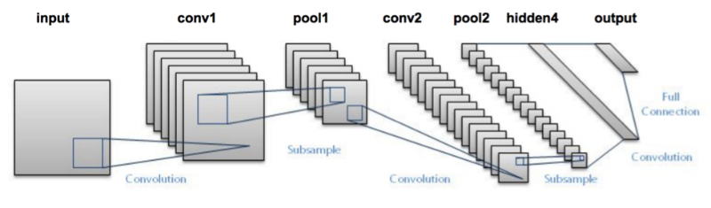
Last time we saw CNNs

Slide 3
Last time we saw CNNs
Good for anything naturally representable as an image (2D array)

Slide 4
Some data has a time component

Slide 5
Some data has a time component
Audio, video

Slide 6
Some data has a time component
Audio, video
Event classification

Slide 7
Some data has a time component
Audio, video
Event classification
Time-dependent processes (e.g. chemical reactions, really any causal system)

Slide 8
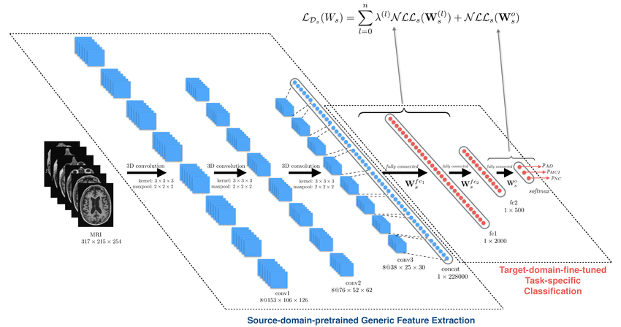
3D CNNs

Slide 9
3D CNNs
Straightforward idea: use convolution voxels rather than windows

Slide 10
3D CNNs
Straightforward idea: use convolution voxels rather than windows
Time relationships treated identically to spatial relationships

Slide 11
Recurrent neural networks (RNNs)

Slide 12
Recurrent neural networks (RNNs)
Capable of emulating a program (learning the I/O mappings of a program)

Slide 13
Recurrent neural networks (RNNs)
Capable of emulating a program (learning the I/O mappings of a program)
Best seen as a sequence -> sequence mapping

Slide 14
Recurrent neural networks (RNNs)
Capable of emulating a program (learning the I/O mappings of a program)
Best seen as a sequence -> sequence mapping
Key: hidden state from previous moments in time are fed into current hidden state!

Slide 15
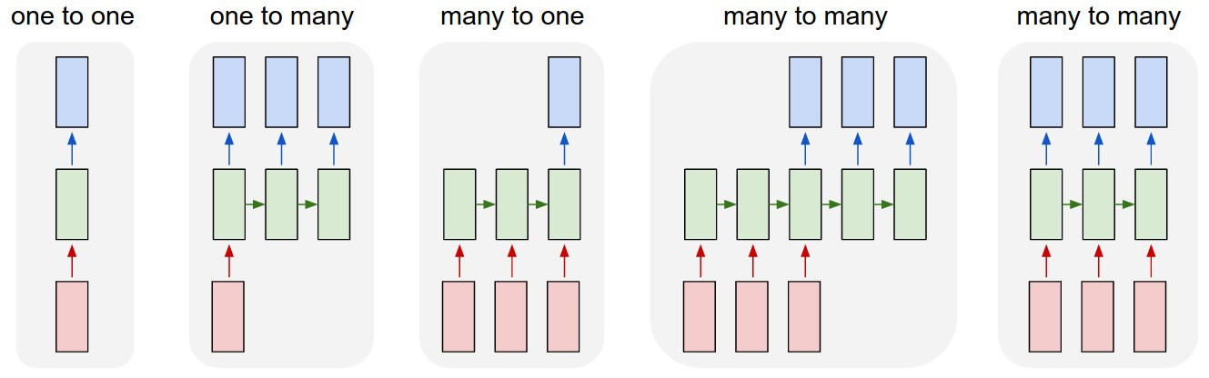
Recurrent neural networks (RNNs)
Sequence-sequence map types

Slide 16
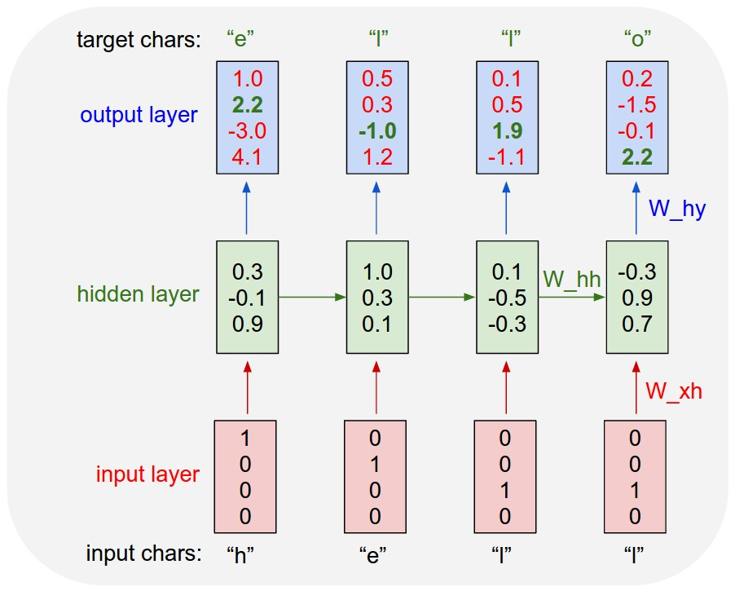
Recurrent neural networks (RNNs)
“Unrolled view”

Slide 17
Main issue: “catastrophic forgetting”

Slide 18
Main issue: “catastrophic forgetting”
On long sequences, RNNs may forget what they saw at the beginning

Slide 19
Main issue: “catastrophic forgetting”
On long sequences, RNNs may forget what they saw at the beginning
Past hidden state is passed in as an input -- distant past washes out

Slide 20
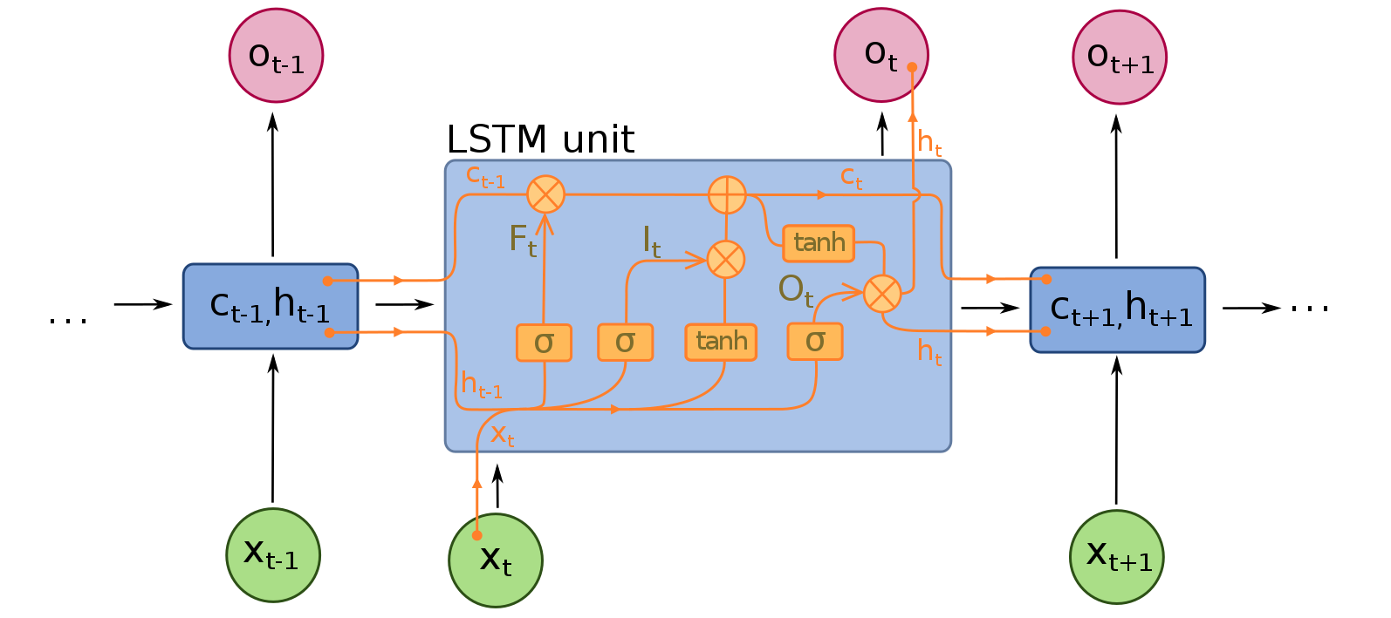
Long short term memory networks (LSTMs)

Slide 21
Long short term memory networks (LSTMs)
Main idea: add in a mechanism that allows for explicit forgetting of old information

Slide 22
RNNs summarize the past

Slide 23
RNNs summarize the past
Net learns a representation of the past (which is mixed with the present)

Slide 24
RNNs summarize the past
Net learns a representation of the past (which is mixed with the present)
Can learn time-based dependencies, but must on the basis of hidden state, not input itself

Slide 25
RNNs summarize the past
Net learns a representation of the past (which is mixed with the present)
Can learn time-based dependencies, but must on the basis of hidden state, not input itself
To reference the input itself, we need a basic memory model (sensation is a super short term form of memory)

Slide 26
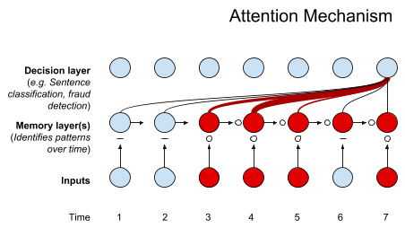
Attention

Slide 27
Attention
“Fuzzy” or “soft” memory access

Slide 28
Attention
“Fuzzy” or “soft” memory access
Allows for end-to-end training with explicit memory

Slide 29
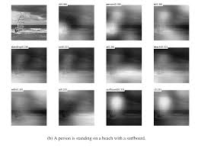
Attention (simple case: 1 frame)

Slide 30
Links
https://www.researchgate.net/publication/304788992_Alzheimer's_Disease_Diagnostics_by_a_Deeply_Supervised_Adaptable_3D_Convolutional_Network (3D CNN)
https://towardsdatascience.com/a-simple-2d-cnn-for-mnist-digit-recognition-a998dbc1e79a (2D CNN)
http://karpathy.github.io/2015/05/21/rnn-effectiveness/ (RNNs)
https://medium.com/@vinayarun/from-scratch-an-lstm-model-to-predict-commodity-prices-179e12445c5a (LSTMs)
https://skymind.ai/wiki/attention-mechanism-memory-network (attention)

